Slide 1
Locations for opening Chinese restaurant in Toronto
Capstone
Fanrui Yan

Slide 2
Analyze data before open restaurant
There are multiple factor to determine if a restaurant going to make profit for not
Location if one of the most important factor
Research and data analyzing is essential to make decisions
In this project, we will try to find locations that are good for Chinese restaurant in Toronto

Slide 3
Data
Based on definition of our problem, factors that will influence our decision are:
Number of existing restaurants
Number of existing Chinese restaurants
Population of neighborhood
Distance of neighborhood from downtown

Slide 4
Data
Centers of initial candidate areas will be found from Wiki page and geographical information can be found from this File
Population of Toronto can be gathered from this webpage, this is population information for the year 2016. With the limitation of data online, we will use it as a reference even though it's not the most recent data
Number of Chinese restaurants in every neighborhood will be obtained using Foursquare API
Coordinate of Toronto downtown has been found through a simple Google search (43.6548, -79.3883)

Slide 5
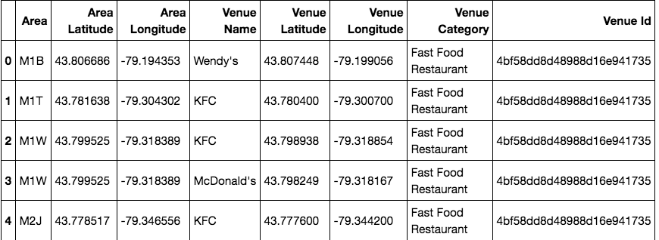
Data cleaning
With all the data gathered, we generated a table that contains Postcode, Latitude, Longitude, and Population:

Slide 6
Methodology
Collect data: location & category of all restaurant in Toronto
Explore restaurant density and population to identify narrower & promising areas
Create clusters of candidate locations that met following requirements:
No more than two restaurants in radius of 500 meters
No Chinese restaurants in radius of 800 meters

Slide 7
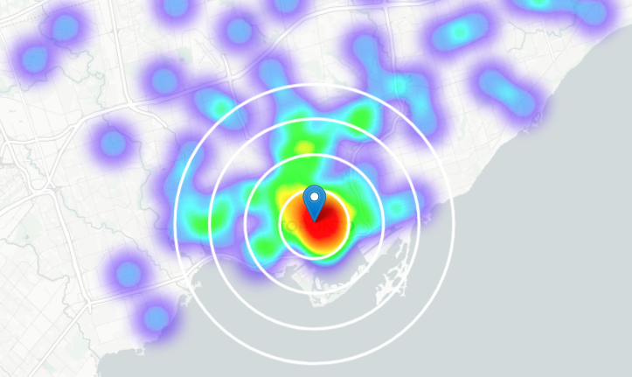
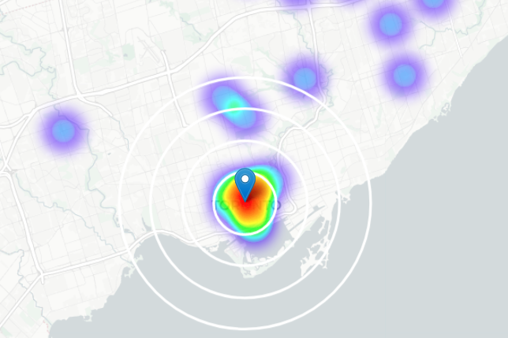
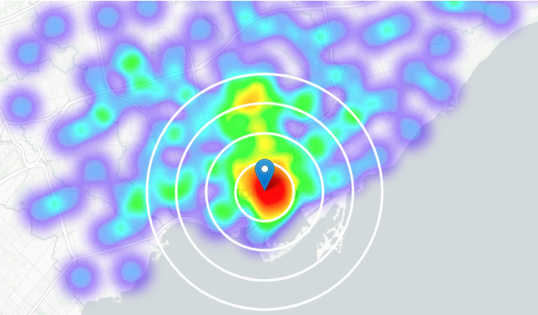
Analysis
All Restaurants
Chinese Restaurants
Population
Per Heatmaps above, we can tell that at about 2~6km north from downtown, there is an area (black circles) that:
the Chinese restaurants density is very low (no color on Heatmap for Chinese Restaurants)
it's quite populated (yellow color in population Heatmap)
the restaurants density is low (green color in All Restaurants Heatmap)

Slide 8
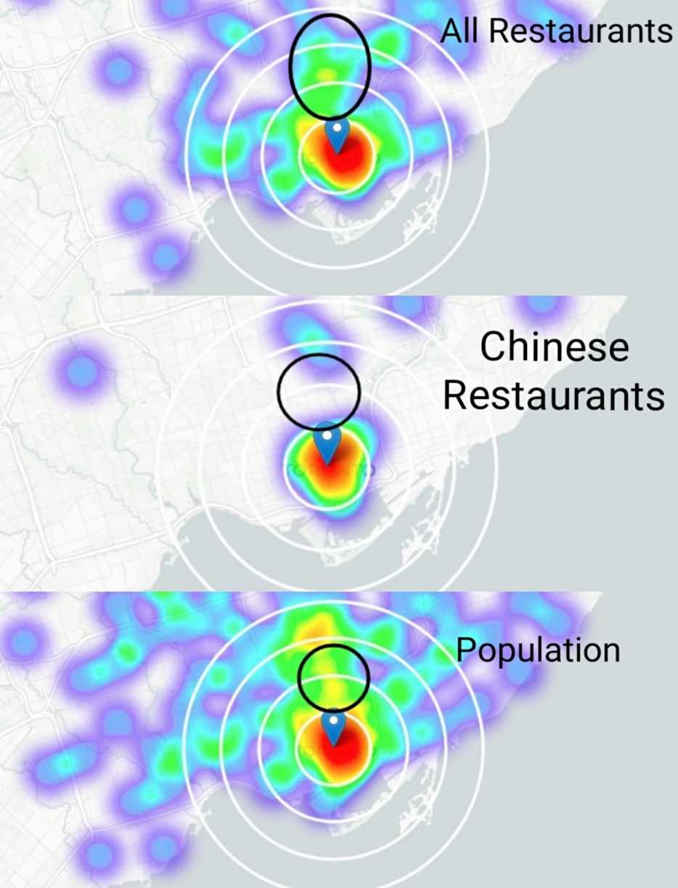
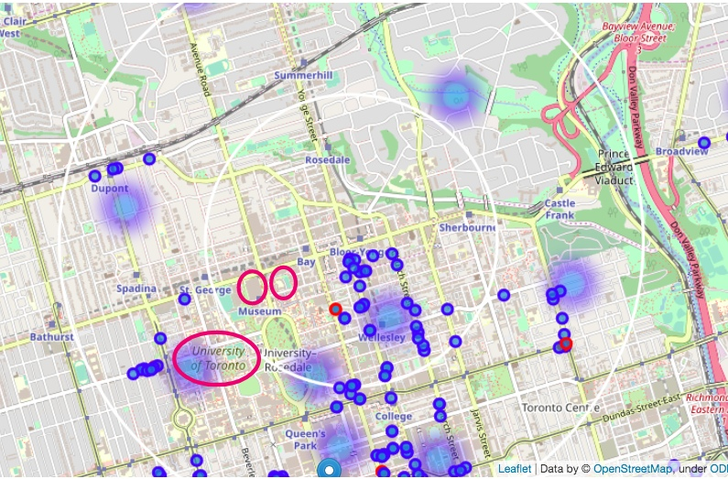
Let’s zoom in to this area:

Slide 9
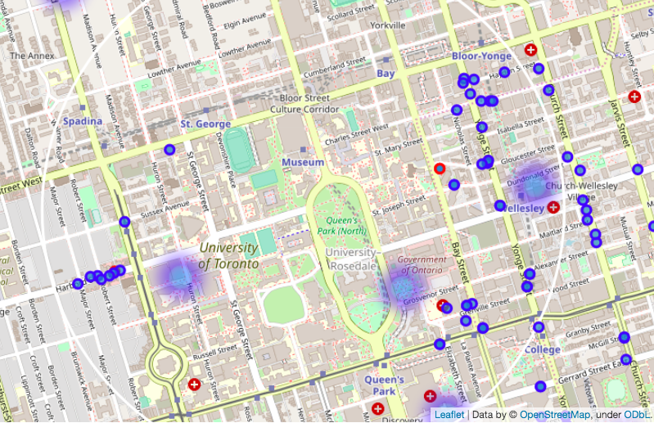
Special locations:
University
of Toronto
Royal Ontario
Museum
Gardiner
Museum
Means high
population of
students and
tourisms

Slide 10
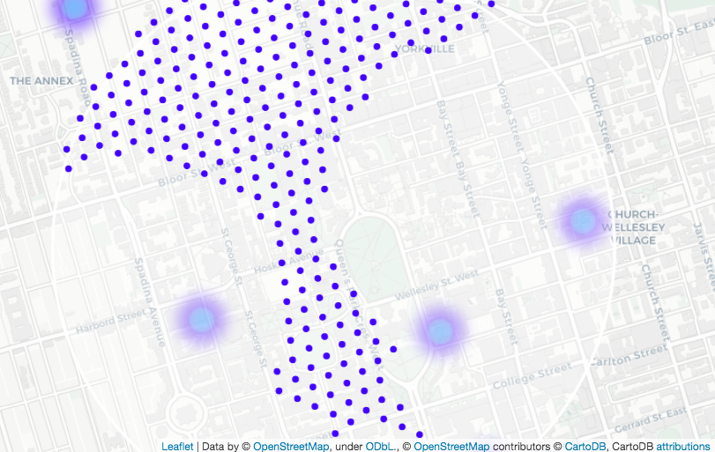
Locations
Less than 2 restaurants in 500 meters
No Chinese restaurant within 800 meters

Slide 11
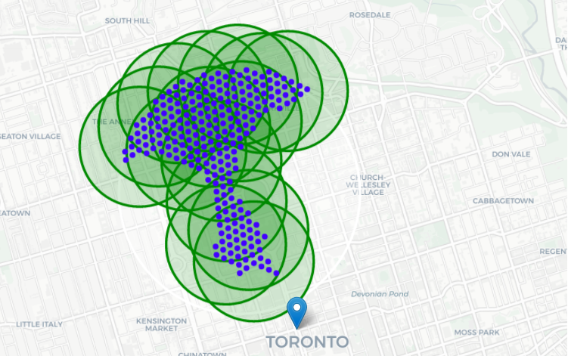
Clustering
Cluster those locations to 15 clusters

Slide 12
Results
Addresses of centers of areas recommended for further analysis:
565 Huron St, Toronto, Ontario, M5R 2R6 => 2.9km from Downtown, Toronto
13 Hoskin Ave, Toronto, Ontario, M5S => 1.8km from Downtown, Toronto
76 Hazelton Ave, Toronto, Ontario, M5R 2E2 => 3.0km from Downtown, Toronto
160 College St, Toronto, Ontario, M5S 3E1 => 1.0km from Downtown, Toronto
139 St George St, Toronto, Ontario, M5R 2L8 => 2.5km from Downtown, Toronto
Amaya Express => 2.9km from Downtown, Toronto
34 Boswell Ave, Toronto, Ontario, M5R 1M4 => 3.0km from Downtown, Toronto
23 Bedford Rd, Toronto, Ontario, M5R 2J9 => 2.6km from Downtown, Toronto
58-98 King's College Cir, Toronto, Ontario, M5S => 1.3km from Downtown, Toronto
273 Bloor St W, Toronto, Ontario, M5S 1W2 => 2.2km from Downtown, Toronto
135 Yorkville Ave, Toronto, Ontario, M5R 0C7 => 2.6km from Downtown, Toronto
Queen's Park Cres W, Toronto, Ontario, M5S => 1.3km from Downtown, Toronto
38 Admiral Rd, Toronto, Ontario, M5R 2L5 => 3.1km from Downtown, Toronto
39 Spadina Rd, Toronto, Ontario, M5R 2S9 => 2.9km from Downtown, Toronto
88 Scollard St, Toronto, Ontario, M5R 1G2 => 2.9km from Downtown, Toronto

Slide 13
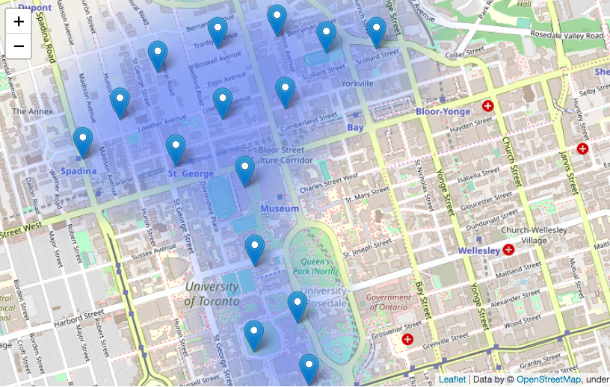
Map of results

Slide 14
Conclusion
These 15 locations are just the start for further research.
Additional factors like attractiveness of each location (proximity to park or water), levels of noise / proximity to major roads, real estate availability, prices, social and economic dynamics of every neighborhood, also need to be considered when making final decision.

